Slide 1
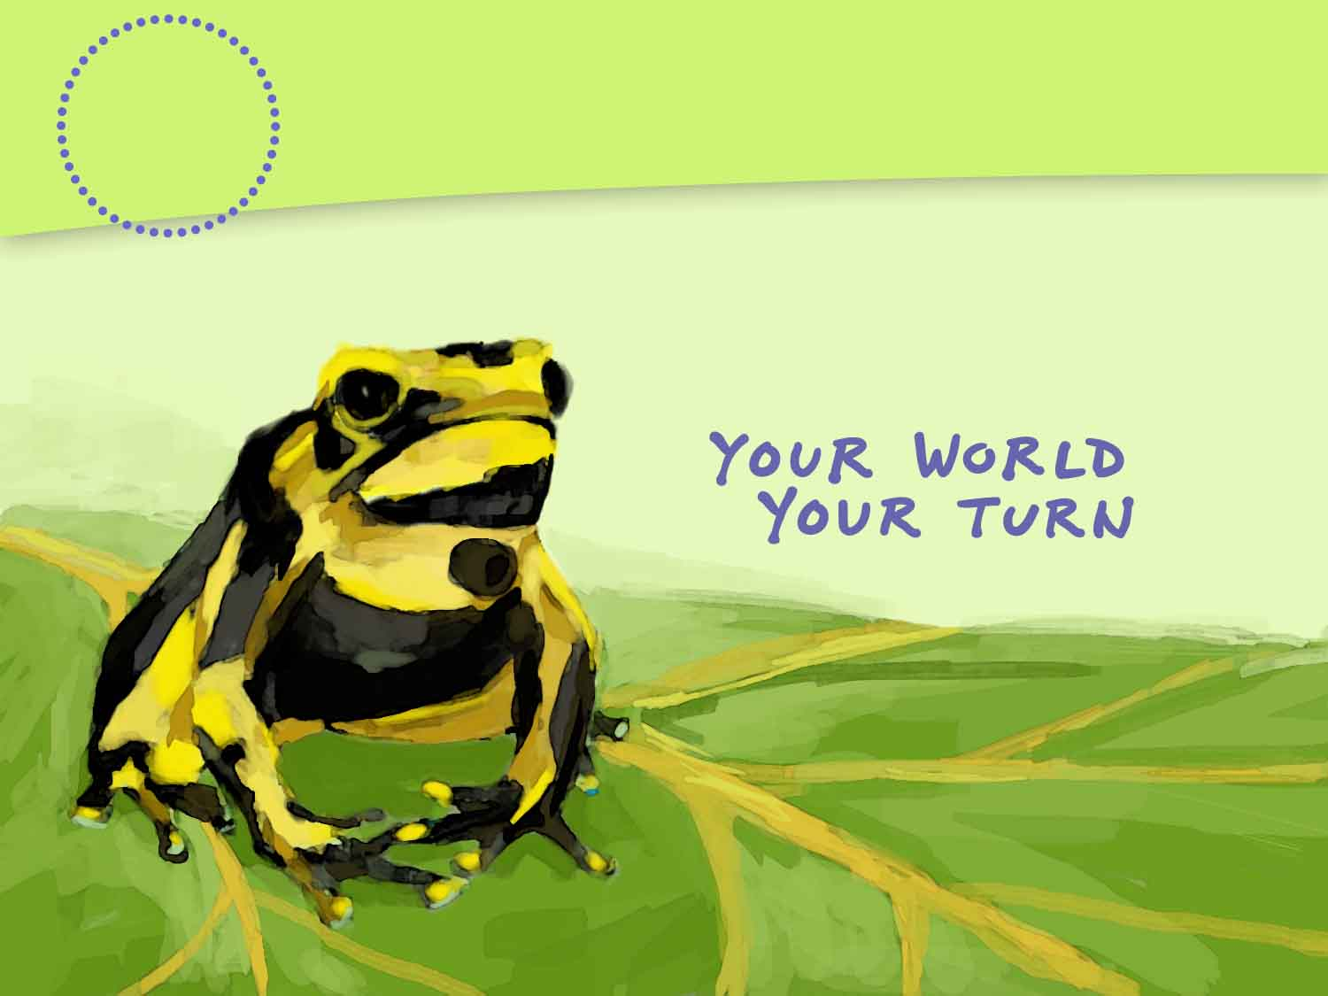
An Introduction to Environmental Science
1
CHAPTER
Notes:
Placeholder opening page, but maybe we can duplicate the look of the SE chapter opener page by using the same fonts and colors (and maybe that Ch 14 icon?)

Slide 2

Fixing a Hole in the Sky
Ozone is a naturally occurring molecule that absorbs and redirects harmful UV radiation.
In the 1970s, Mario Molina and Sherwood Rowland discovered that CFCs were rapidly destroying ozone in the stratosphere.
Today, most nations have banned CFCs, and the ozone hole is expected to close up around 2050.
Talk About It Should environmental scientists’ discoveries about the natural world influence human activity? If so, how?

Slide 3
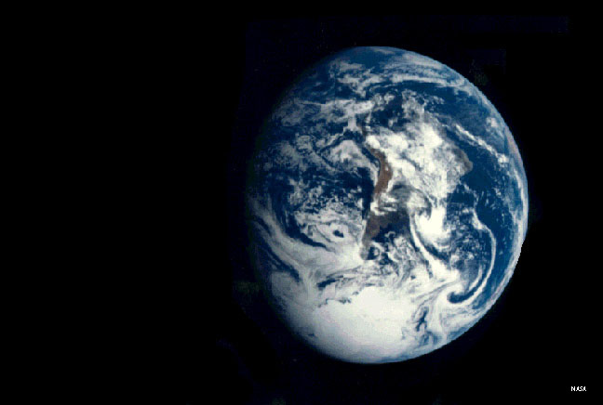
Lesson 1.1 Our Island, Earth
Like all species on Earth, humans rely on a healthy, functioning planet for air, water, food, and shelter.

Slide 4
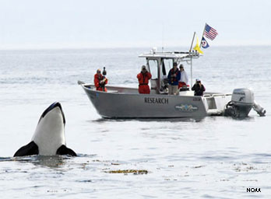
What Is Environmental Science?
Lesson 1.1 Our Island, Earth
The study of our planet’s natural systems and how humans and the environment affect one another
The environment includes all living and nonliving things with which organisms interact.
Understanding the interactions between humans and the environment is the first step to solving environmental problems.
National Marine Fisheries Service scientists studying whether commercial boats are harming endangered killer whales

Slide 5
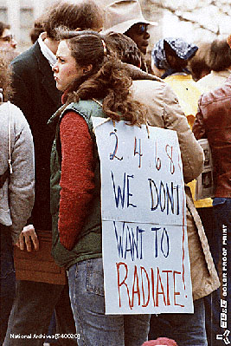
Environmental Science vs. Environmentalism
Lesson 1.1 Our Island, Earth
Environmental Science: Objective, unbiased pursuit of knowledge about the workings of the environment and our interactions with it
Environmentalism: Social movement dedicated to protecting the natural world
Environmentalists protesting the use of nuclear power

Slide 6
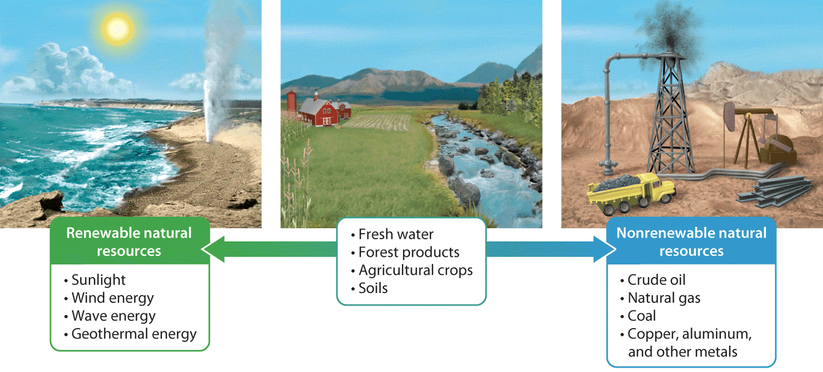
Natural Resources
Lesson 1.1 Our Island, Earth
Natural resources are materials and energy sources found in nature that humans need to survive.
  Renewable resources: Naturally replenished over short periods
  Nonrenewable resources: Naturally formed more slowly than we use them.
  Renewable resources can become nonrenewable if used faster than they are replenished.

Slide 7
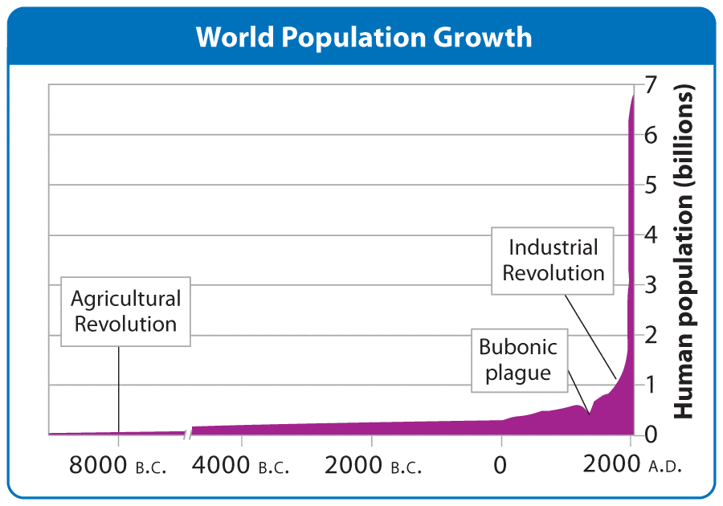
Human Population Growth
Lesson 1.1 Our Island, Earth
• Tremendous and rapid human population growth can be attributed to:
  • The Agricultural Revolution: About 10,000 years ago; humans began living in villages, had longer life spans, and more surviving children.
  • Industrial Revolution: Began in early 1700s; driven by fossil fuels and technological advances
Did You Know? The human population increases by about 200,000 people every day.
Notes:
Image - http://www.flickr.com/photos/carolynconner/4264882098/ (Creative Commons licensed)
Geyser info source - National Park Service: http://www.nps.gov/yell/planyourvisit/noldfaith.htm

Slide 8
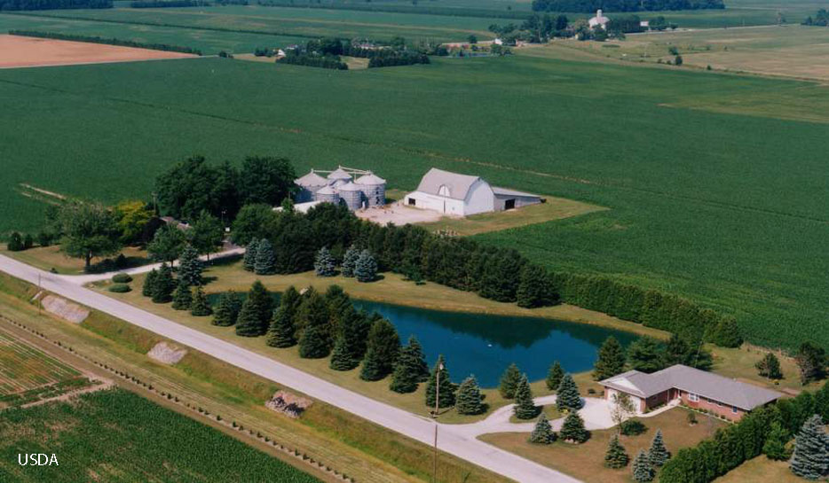
Ecological Footprints
Lesson 1.1 Our Island, Earth
The total amount of land and water required to:
  provide the raw materials an individual or population consumes
  dispose of or recycle the waste an individual or population consumes
Most informative when footprints are calculated using the same method
Ecological footprints include land and water used to grow food at farms hundreds or thousands of miles away.
Did You Know? By one calculation, the ecological footprint of the average American is 3.5 times the global average.

Slide 9
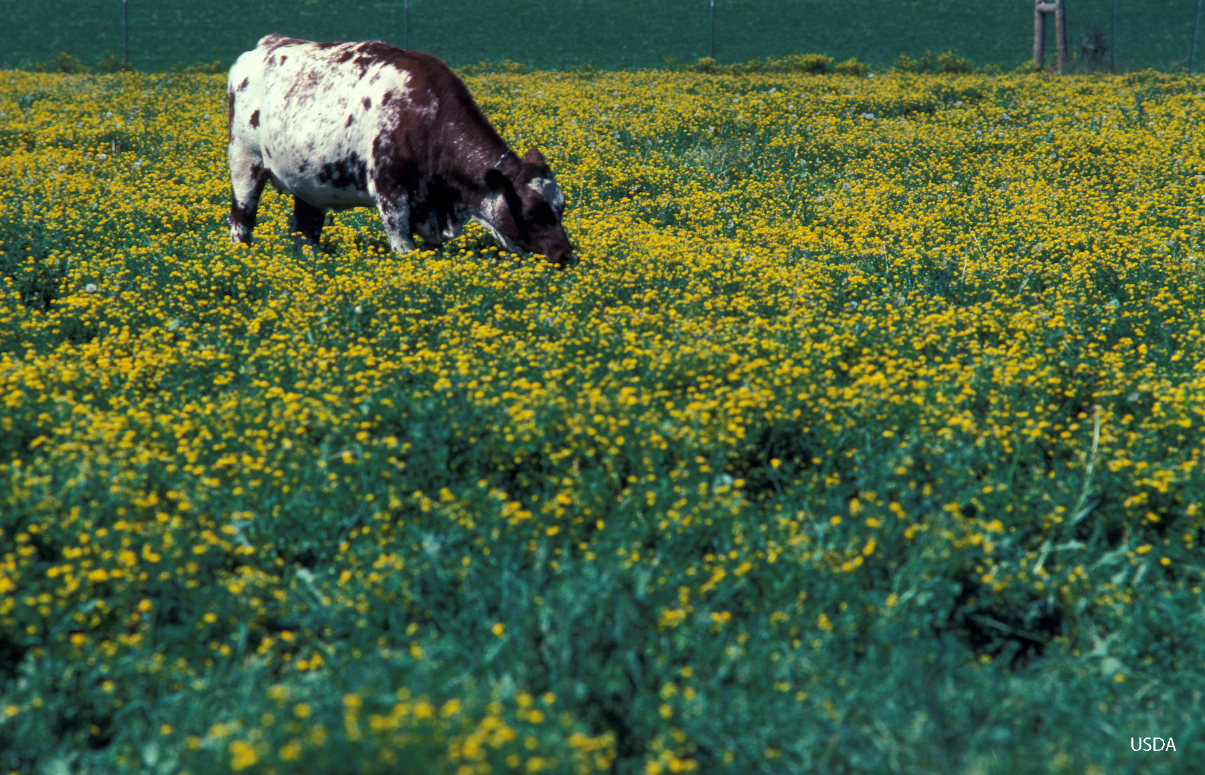
Tragedy of the Commons
Lesson 1.1 Our Island, Earth
Describes a situation in which resources, made available to everyone, are used unsustainably and eventually depleted
Resource management, whether voluntary or mandated, can help avoid resource depletion.
The “commons” refers to a public pastureland that was shared by villagers in 19th-century England.

Slide 10
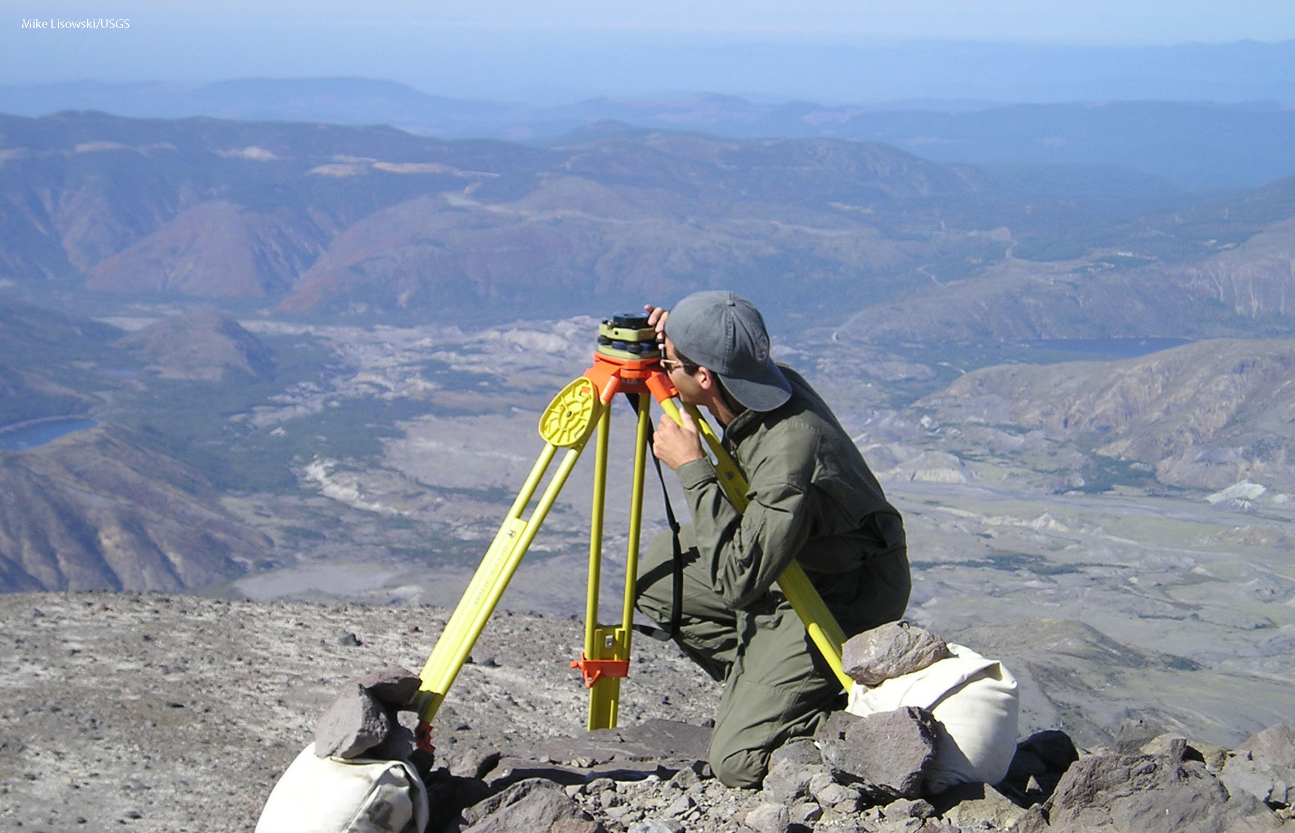
Lesson 1.2 The Nature of Science
The word science comes from the Latin word scientia, meaning “knowledge.”

Slide 11
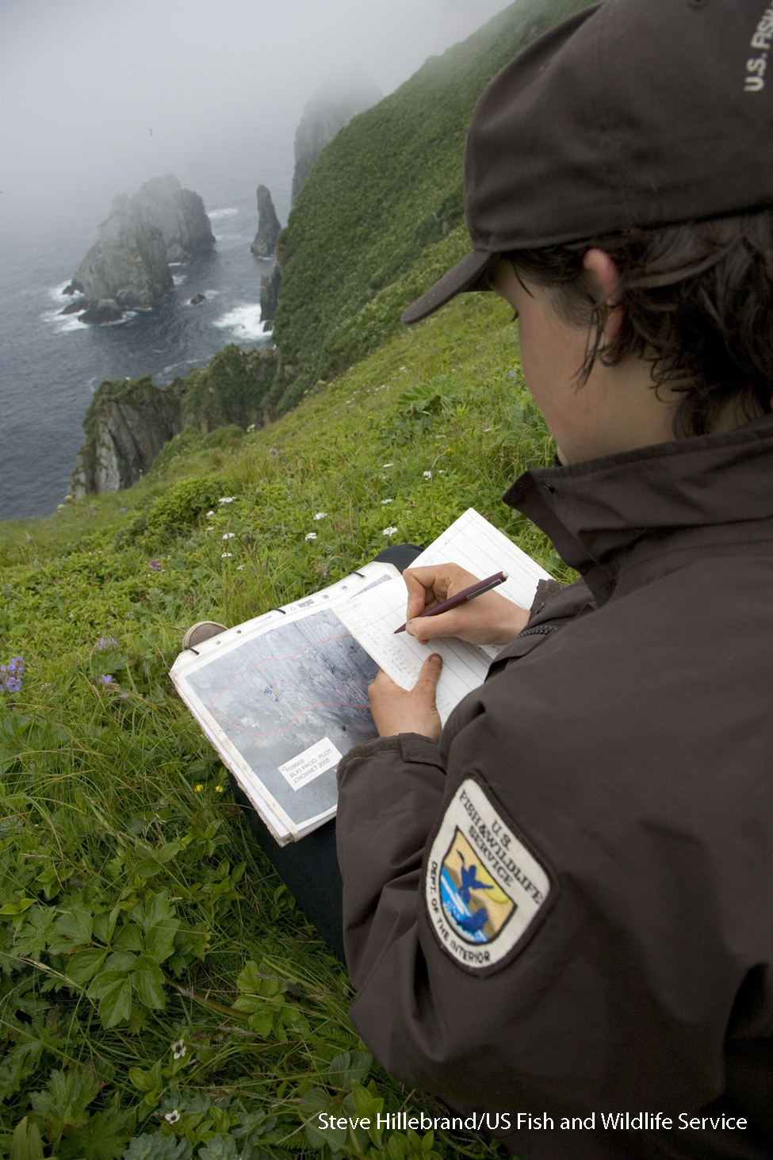
What Science Is and Is Not
Lesson 1.2 The Nature of Science
Science is an organized way of studying the natural world, and the knowledge gained from such studies.
Science assumes that the natural world functions in accordance with rules that do not change.
Science does not deal with the supernatural.
Science relies on evidence from measurements and observations.
Scientific ideas are “supported,” not “proven,” and “accepted,” not
“believed in.”

Slide 12
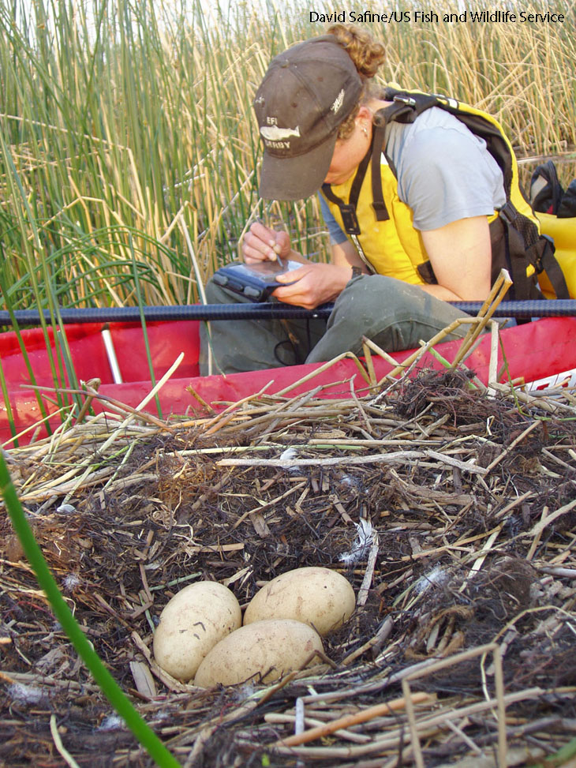
The Process of Science
Lesson 1.2 The Nature of Science
Science involves asking questions, making observations, seeking evidence, sharing ideas, and analyzing results.
Science is not linear—the process loops back on itself and follows many different paths.
Science is a dynamic, creative endeavor.

Slide 13
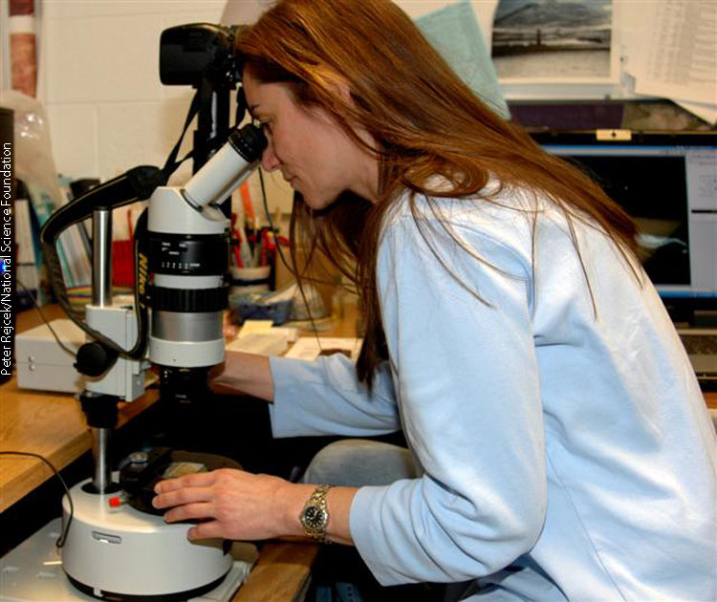
Exploration and Discovery
Lesson 1.2 The Nature of Science
Many investigations start with the observation of a phenomenon that the scientist wishes to explain.
Observations can be made with the eye, with instruments, or by reading scientific literature.
Observations can happen unexpectedly or be planned.
Observations often lead to questions and may be shared with colleagues.

Slide 14
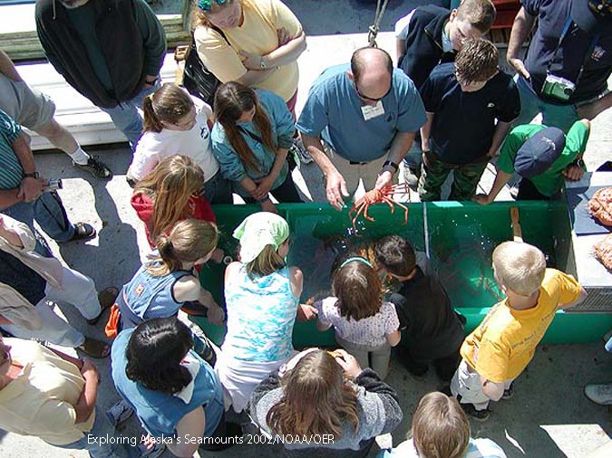
Hypotheses
Lesson 1.2 The Nature of Science
Scientists attempt to answer questions by devising hypotheses—testable ideas
Hypotheses:
  Explain a phenomenon or answer a scientific question
  Generate predictions that can be checked with models or direct observation (A prediction is the expected observation if the hypothesis is true.)
  Can be supported or rejected by data
  May prompt new hypotheses

Slide 15
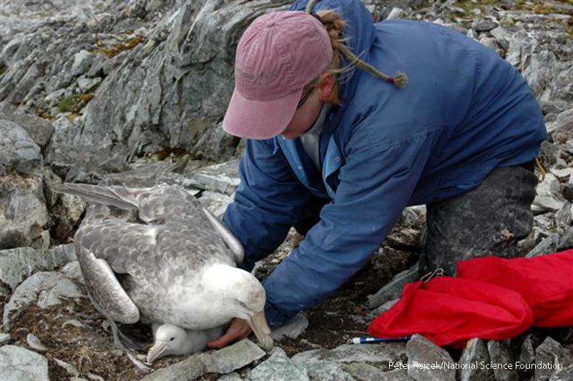
Gathering Data
Lesson 1.2 The Nature of Science
Scientists test predictions by gathering evidence in the form of data.
  If data match predictions, hypothesis is supported.
  If data do not match predictions, hypothesis is rejected.
Data can come from an experiment or observational studies; ideally experiments and studies are controlled and repeated.
Did You Know? Gulls are protected by the Migratory Bird Treaty Act, and government agencies like the U.S. Fish and Wildlife Service continually collect data on seagull populations and habitats.

Slide 16
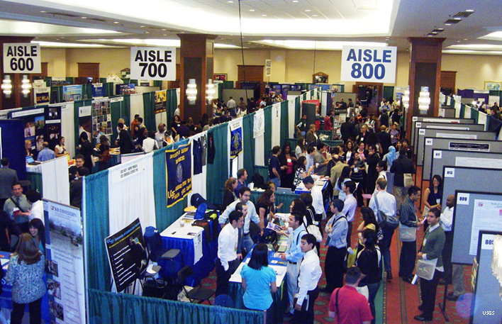
Lesson 1.3 The Community of Science
Scientific research does not stop with the scientific method. In order to have any impact, scientists must share their work at conferences and in journals. They receive and incorporate feedback.

Slide 17
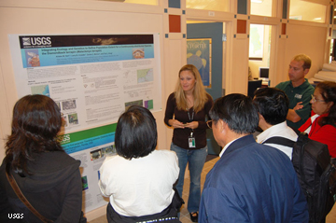
Community Analysis and Feedback
Lesson 1.3 The Community of Science
After completing their study, scientists:
  Present their work and get feedback from other researchers at conferences
  Write papers about their study
  Submit papers for publication in a journal
Many journals are peer-reviewed, meaning scientists review papers submitted for publication, recommend changes, and reject or accept the paper for publication.

Slide 18
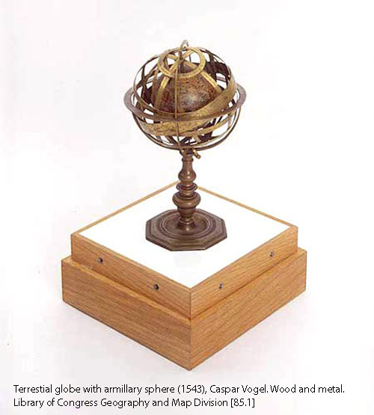
Replication and Self-Correction
Lesson 1.3 The Community of Science
Hypotheses should be tested several times, in several ways, before they are accepted.
Interpretations of data can change over time as knowledge accumulates.
Sometimes reinterpretations can be drastic, but most of the time they are minor adjustments to an accepted idea.
Science constantly refines and improves itself.
Did You Know? Scientists believed the sun and planets revolved around the Earth until Nicolaus Copernicus proved this was false in the 1500s.

Slide 19
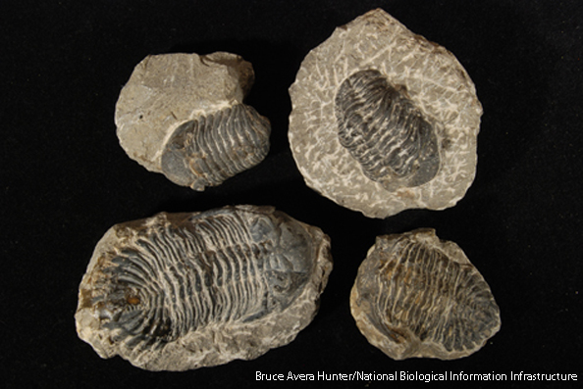
Scientific Theory-Building
Lesson 1.3 The Community of Science
A hypothesis is a testable explanation for a narrow set of phenomena, while a theory is a broader explanation for a wider range of observations.
Both hypotheses and theories must be testable, supported by multiple lines of evidence, and replicated to be accepted by the scientific community.

Slide 20
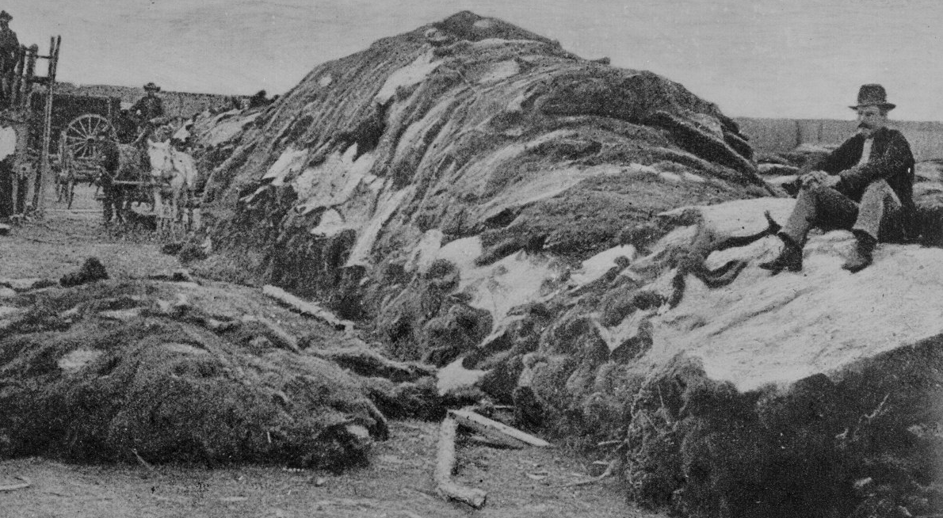
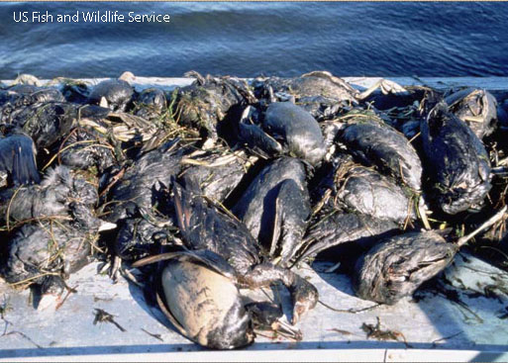
Building on Environmental Science
Lesson 1.3 The Community of Science
Addressing environmental problems involves more than just understanding the science.
  Ethics: Study of behavior (good and bad, right and wrong), moral principles, and values
  Culture: Ensemble of knowledge, beliefs, values, and learned ways of life shared by a group of people
  Worldview: Perception of the world and a person’s place in it
40,000 buffalo hides, 1872
Ducks killed by an oil spill

Slide 21
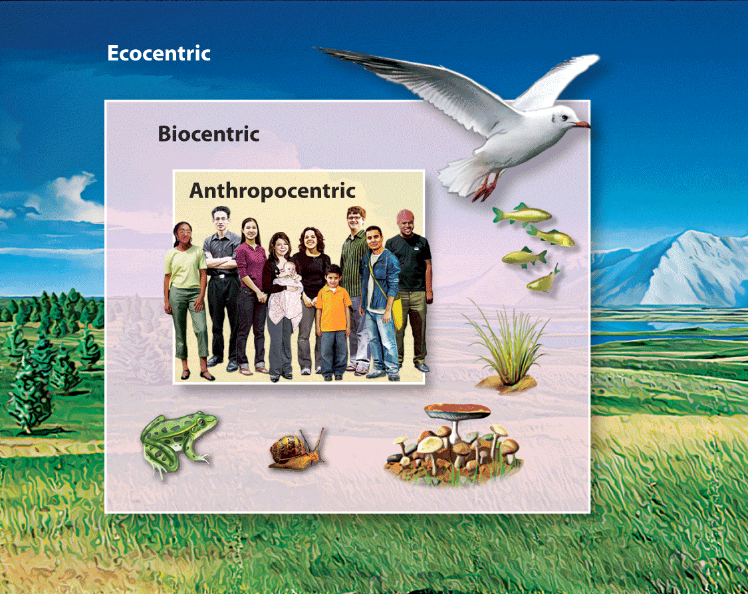
Environmental Ethics
Lesson 1.3 The Community of Science
Environmental ethics is the application of ethical standards to the relationship between humans and the environment.
  Anthropocentrism: Humans and human welfare most important
  Biocentrism: All living things have value; some may be more important than others
  Ecocentrism: Well-being of a species or community more important than that of an individual

Slide 22

Environmental Justice
Lesson 1.3 The Community of Science
The environmental justice movement:
  Recognizes that quality of life is connected to environmental quality
  Promotes fair and equitable treatment of all people regarding environmental policy and practice

