Slide 1

Economics and
Environmental Policy
2
CHAPTER
Notes:
Placeholder opening page, but maybe we can duplicate the look of the SE chapter opener page by using the same fonts and colors (and maybe that Ch 14 icon?)

Slide 2

Cleaning the Tides of
San Diego and Tijuana
The heavily polluted Tijuana River crosses over from Mexico to the U.S. and empties into the Pacific Ocean near San Diego, California, forcing frequent beach closures.
Pollution sources include U.S.-owned factories as well as Mexican farms, homes, and sewage treatment plants.
In 1990 the U.S. and Mexico agreed to build a wastewater treatment plant, but construction has yet to be completed.
Talk About It Why is the pollution problem in the Tijuana River particularly difficult to solve? How does this case illustrate the connections between the environment, the economy, and government policy?

Slide 3
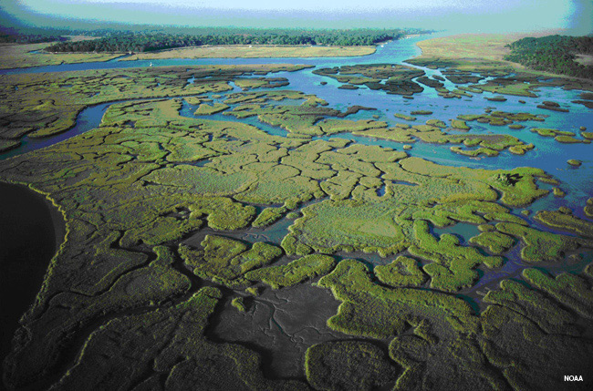
Lesson 2.1 Economics
A 1997 study calculated the overall economic value of ecosystems worldwide at about $33 trillion per year— more than the combined gross domestic product (GDP) of every nation in the world at the time.

Slide 4
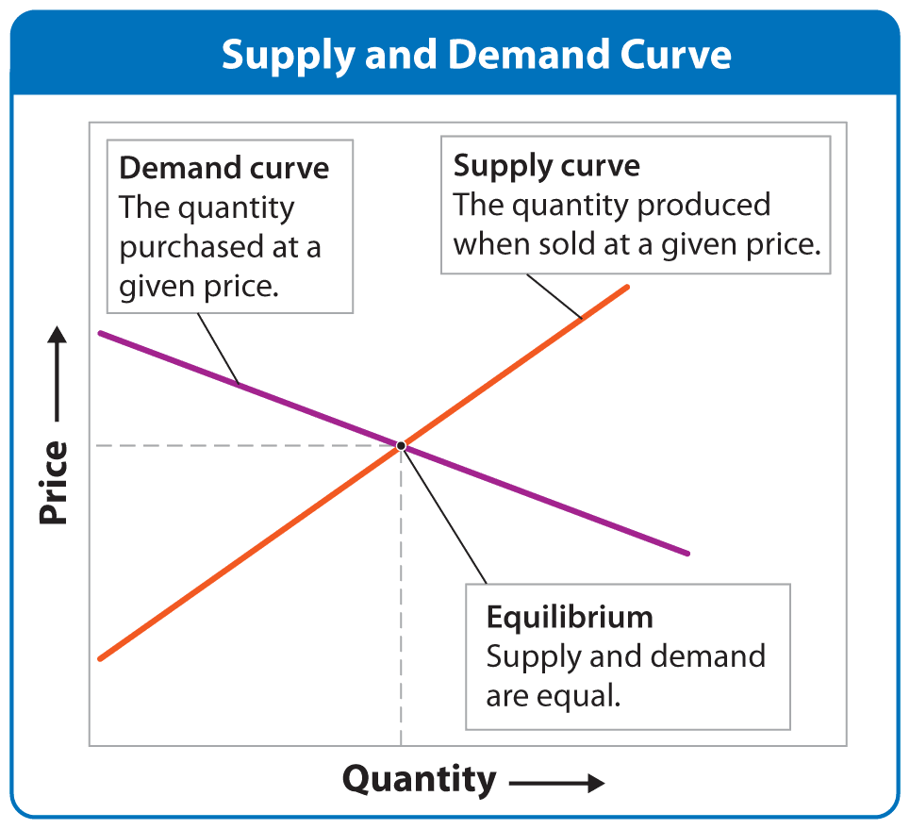
What Is Economics?
Lesson 2.1 Economics
The study of how resources are used and distributed
Markets tend to move toward equilibrium, where demand for a product matches supply.
Cost-benefit analysis is a decision-making tool that compares an activity’s gains and costs.

Slide 5
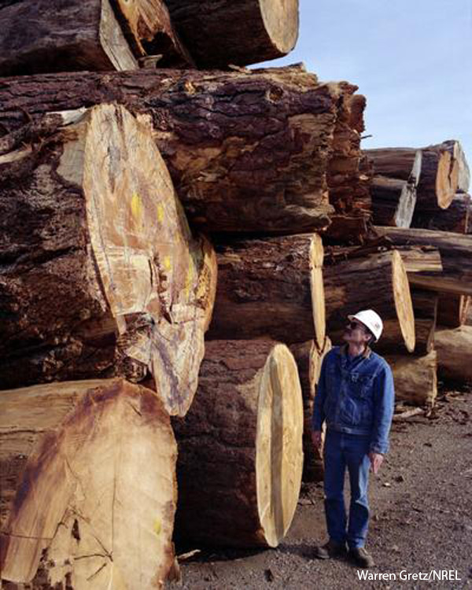
Economics and the Environment
Lesson 2.1 Economics
Economies depend on the environment for goods and services.
  Goods: Sunlight, fresh water, timber, and fossil fuels
  Services: Nutrient cycling and purification of air and water
Economic activity can negatively affect the environment, which in turn can negatively affect economies.

Slide 6
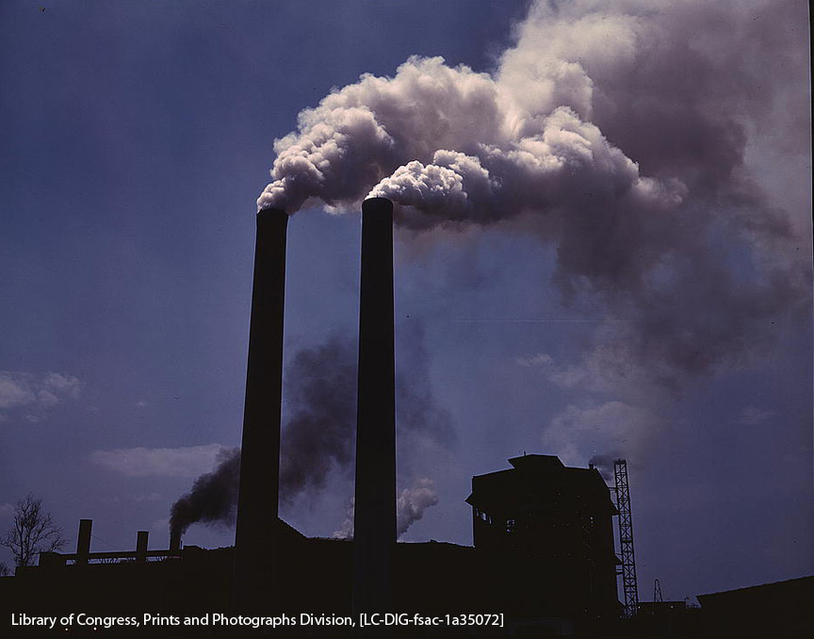
Harmful Economic Assumptions
Lesson 2.1 Economics
These long-held economic assumptions have had negative impacts on the environment:
  Costs and benefits only affect buyers and sellers.
  Short-term costs and benefits should be emphasized.
  Resources are unlimited.
  Economic growth is continual.

Slide 7
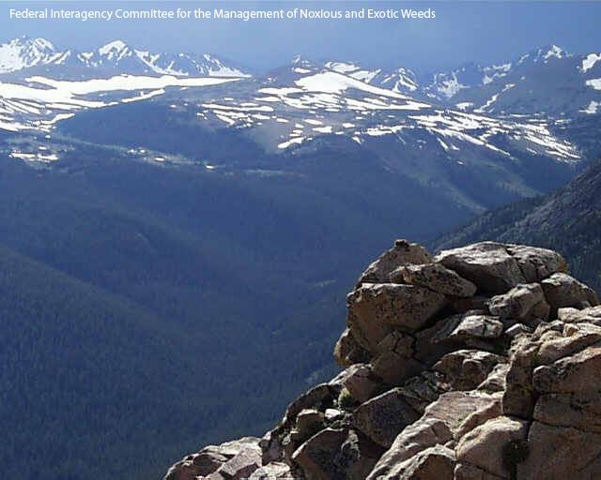
Environmental Economics
Lesson 2.1 Economics
Applies the principles of Earth’s systems to economics
Argues that economies cannot be sustainable unless environmental issues are addressed
Assigns market values to ecosystem services
Suggests that market failure will occur unless market values reflect environmental costs and benefits
Clear views and natural beauty have aesthetic value, which is a type of non-market value.
Notes:
Image - http://www.flickr.com/photos/carolynconner/4264882098/ (Creative Commons licensed)
Geyser info source - National Park Service: http://www.nps.gov/yell/planyourvisit/noldfaith.htm

Slide 8


Consumer and Corporate Responses
Lesson 2.1 Economics
Changing consumer values can drive corporations to pursue sustainability.
Ecolabeling is an example of a corporate response to the call for sustainable goods and services.
Did You Know? Organic farming is one of the fastest-growing segments of U.S. agriculture. Land devoted to growing organic has expanded by about 15% each year since 2002.

Slide 9
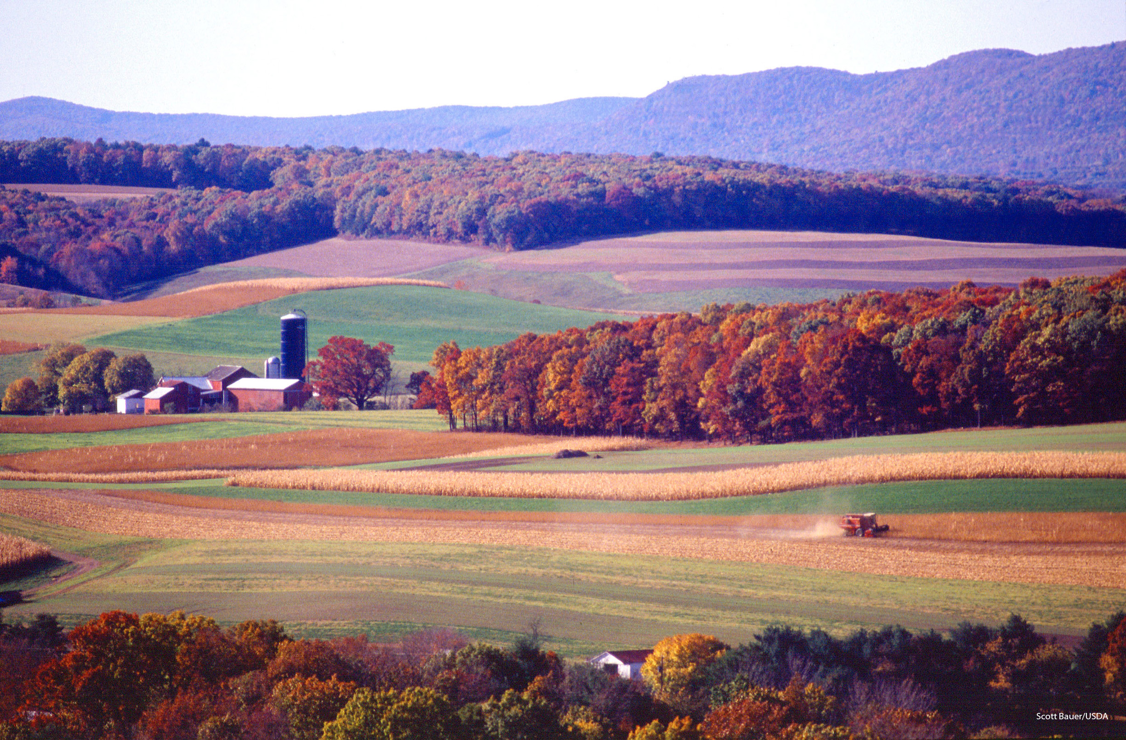
Lesson 2.2 United States Environmental Policy
The Homestead Act of 1862 allowed any citizen, for just $16, to claim 65 hectares (160 acres) of public land, as long as they lived on it for five years and either built a house or cultivated the land.

Slide 10
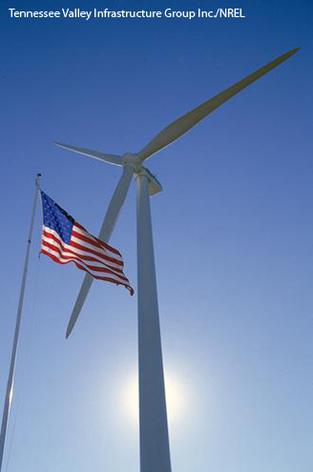
What Is Environmental Policy?
Lesson 2.2 United States Environmental Policy
A set of general plans and principles for interactions between humans and the environment
Effective environmental policy involves input from science, ethics, and economics.
In the U.S., all three branches of government (legislative, executive, and judicial) are involved in federal environmental policy.

Slide 11

State and Local Environmental Policy
Lesson 2.2 United States Environmental Policy
State and local environmental policies cannot violate the U.S. Constitution.
The strength of environmental policy differs from state to state.
States that experience environmental disasters tend to have stronger environmental laws.

Slide 12
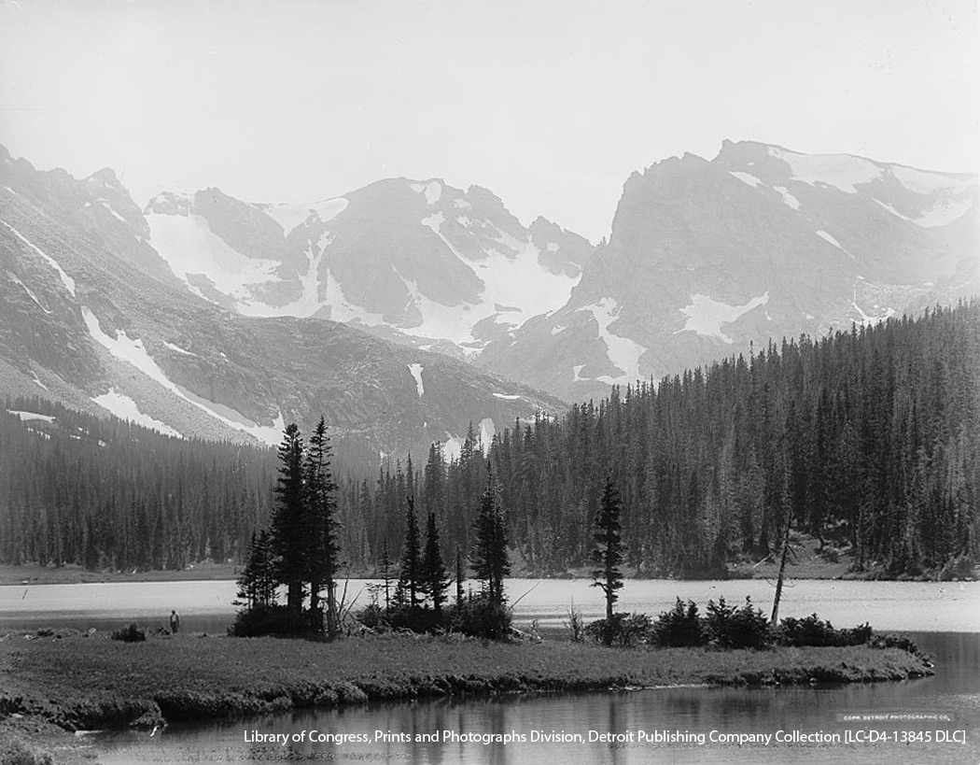
History of U.S. Environmental Policy: The First Period
(1780s to late-1800s)
Lesson 2.2 United States Environmental Policy
Laws enacted during this period dealt primarily with management of public lands as the nation expanded west.
General feeling was that resources and land were in endless supply.
Long Lake in the Rocky Mountains, near Ward, CO

Slide 13
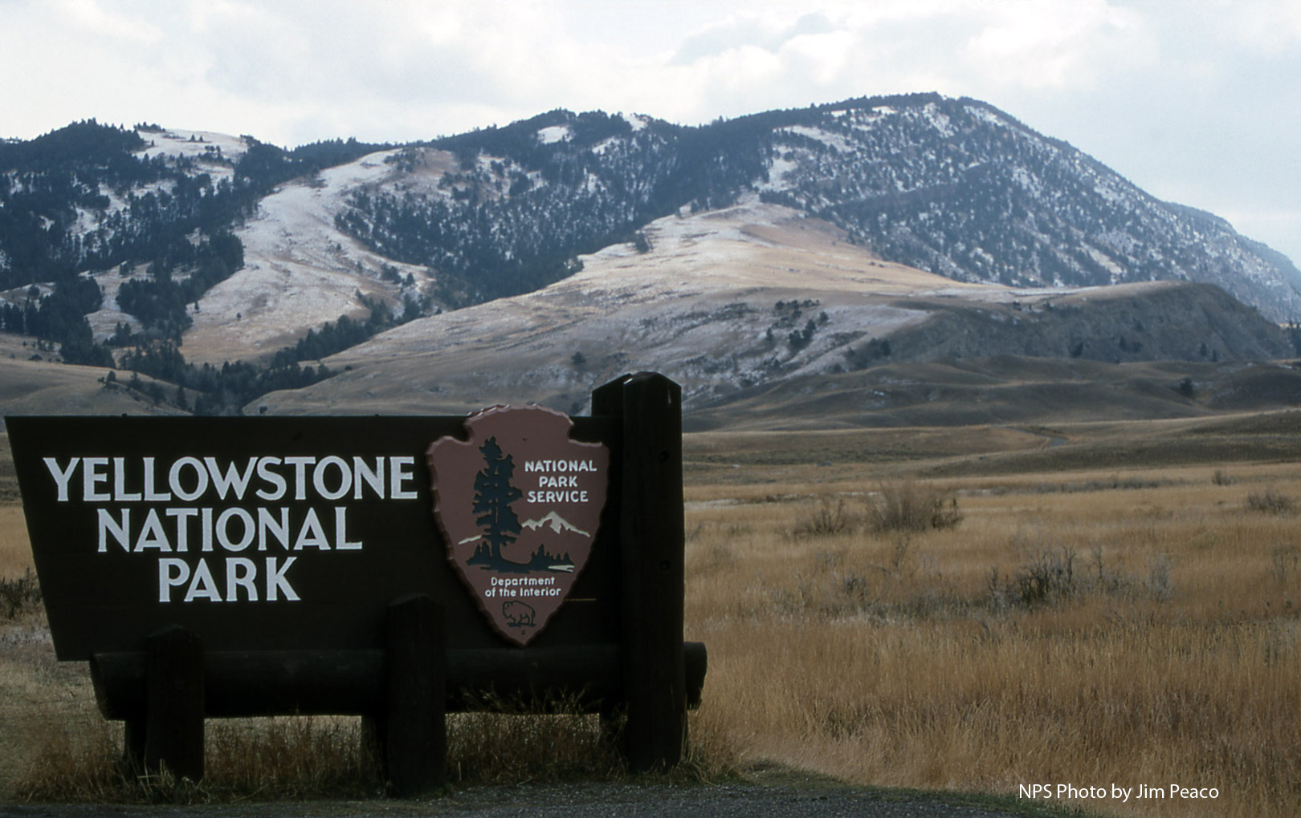
The Second Period
(late 1800s to mid-1900s)
Lesson 2.2 United States Environmental Policy
Policies sought to reduce environmental problems associated with westward expansion.
Led to the formation of national forest system and national park system

Slide 14
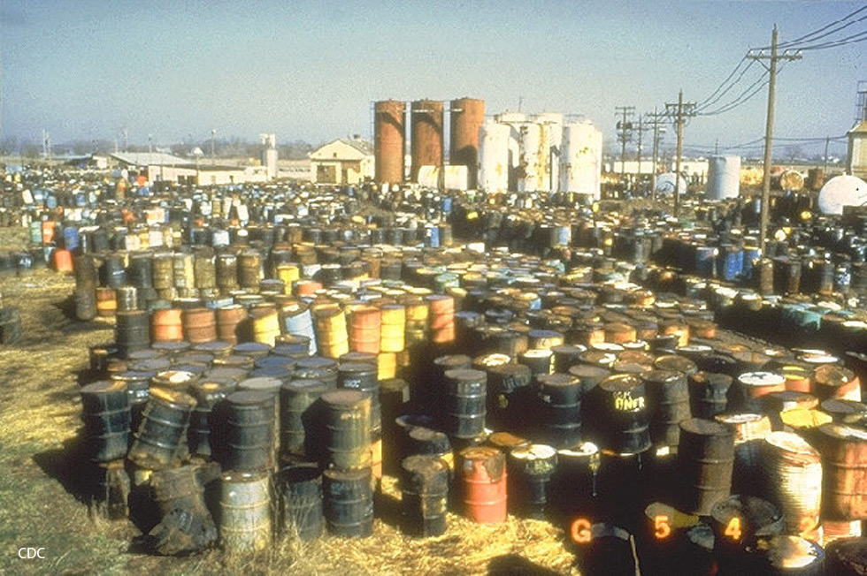
The Third Period
(mid- to late-1900s)
Lesson 2.2 United States Environmental Policy
Dense populations led to increasing resource consumption and pollution.
Silent Spring and fires on the Cuyahoga River raised environmental awareness.
Policy began to reflect the connection between human and environmental health.
Did You Know? Rachel Carson’s Silent Spring, published in 1962, awakened the public to the dangers of industrial chemicals and DDT.

Slide 15
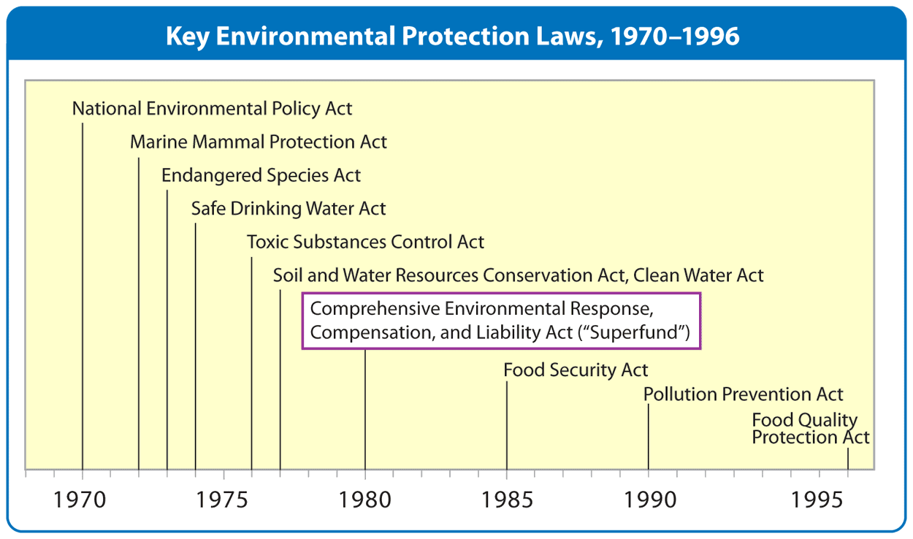
Modern U.S. Environmental Policy
Lesson 2.2 United States Environmental Policy
National Environmental Policy Act: Requires government agencies and contractors to evaluate the environmental impact of a project; led to the formation of the EPA
Environmental Protection Agency (EPA): Responsible for monitoring, enforcing, and researching environmental quality

Slide 16

Lesson 2.3 International Environmental Policy and Approaches
The United Nations Environment Programme (UNEP) was established in 1972 with the mission of helping countries achieve sustainability.

Slide 17
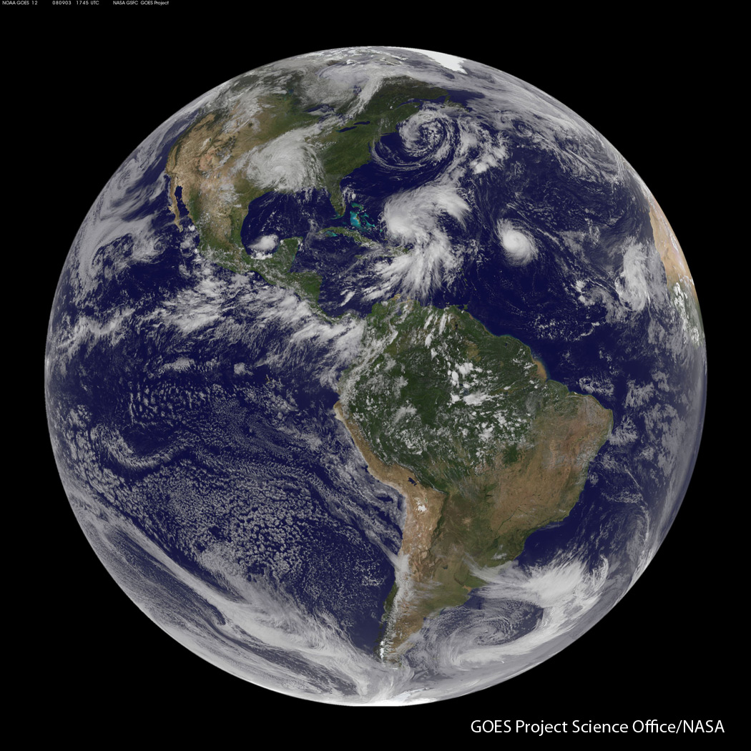
International Environmental Policy
Lesson 2.3 International Environmental Policy and Approaches
Environmental issues often involve more than one nation.
International organizations promote cooperation between nations:
      The United Nations
      The European Union
      The World Trade Organization
      The World Bank
Non-governmental organizations (NGOs), such as Greenpeace, influence international policies and contribute to research and funding.

Slide 18
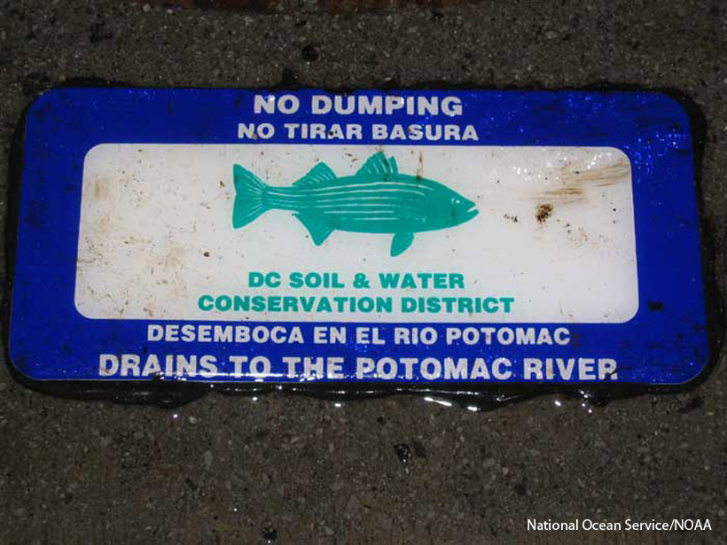
Approaches to Environmental Policy
Lesson 2.3 International Environmental Policy and Approaches
Command-and-control
Tax breaks and subsidies
Green taxes
Cap-and-trade
Local incentives
No dumping signs are an example of command-and-control.
Did You Know? The cap-and-trade approach in the U.S. has helped reduce sulfur dioxide emissions that cause acid rain by 35%.

Slide 19
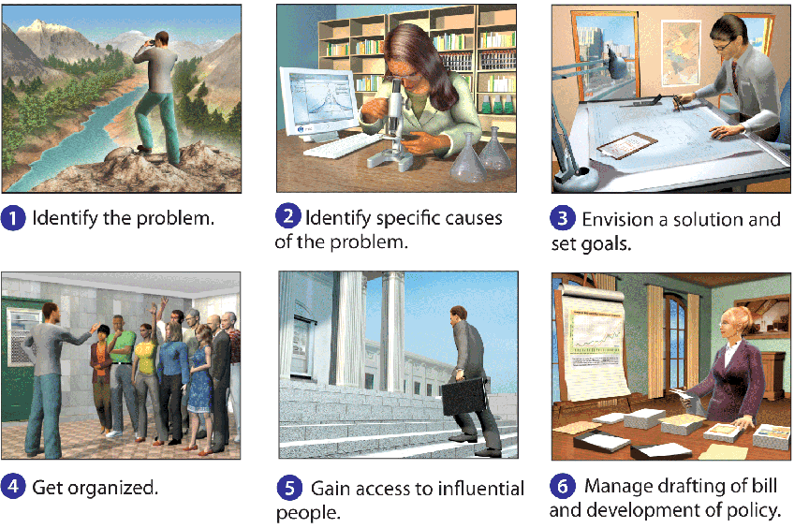
The Environmental Policy Process
Lesson 2.3 International Environmental Policy and Approaches

