Slide 1
Earth’s Environmental Systems
3
CHAPTER
Notes:
Placeholder opening page, but maybe we can duplicate the look of the SE chapter opener page by using the same fonts and colors (and maybe that Ch 14 icon?)

Slide 2
The Gulf of Mexico’s Dead Zone
Nutrient-rich runoff causes plankton blooms and hypoxia—low oxygen levels—in the Gulf of Mexico.
Hypoxia kills or displaces marine organisms, causing a decline in the fisheries and the fishing industry.
U.S. government and farmers debate the need to cut down on fertilizer use.
Talk About It Do you think the distance between the source of the nitrogen and phosphorus and the dead zones themselves makes it difficult to manage this problem? Why or why not?

Slide 3
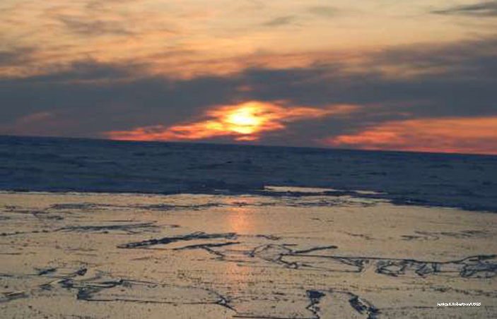
Lesson 3.1 Matter and the Environment
Water’s abundance is a primary reason there is life on Earth.

Slide 4
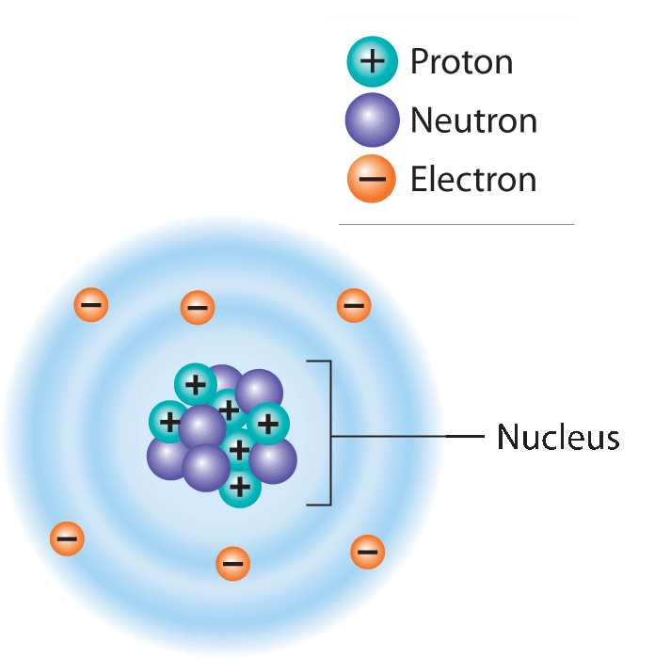
Atoms and Elements
Lesson 3.1 Matter and the Environment
Atoms are the basic unit of matter.
Nucleus: Contains protons and neutrons
Electrons: Move around the nucleus
An element is a substance that cannot be broken down into other substances.
Did You Know? There are 92 elements that occur naturally, and scientists have created about 20 others in labs.

Slide 5
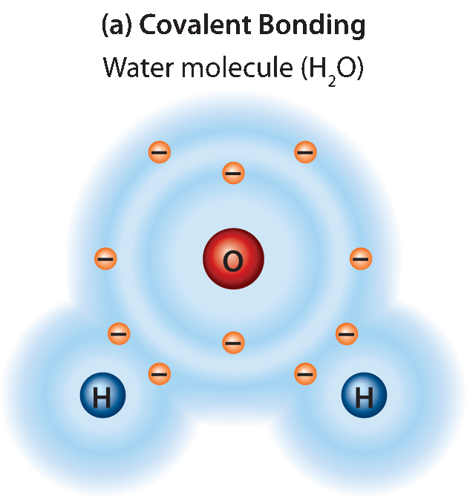
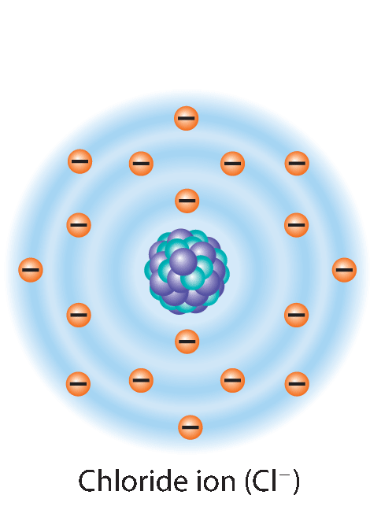
Bonding
Lesson 3.1 Matter and the Environment
Atoms combine by bonding:
Covalent bonds: Electrons are shared.
Ionic bonds: Electrons are transferred.
Molecule: Two or more atoms joined by covalent bonds
Compound: Substance composed of atoms of two or more different elements
Covalent bonding
Ionic bonding

Slide 6
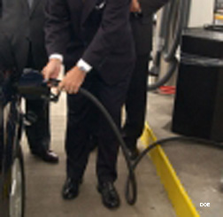
Organic and Inorganic Compounds
Lesson 3.1 Matter and the Environment
Organic compounds: Consist of covalently bonded carbon atoms and often include other elements, especially hydrogen
Hydrocarbons: Organic compounds, such as petroleum, that contain only hydrogen and carbon
Inorganic compounds: Lack carbon-to-carbon bonds
Organic compounds include natural gas, petroleum, coal, and gasoline.

Slide 7
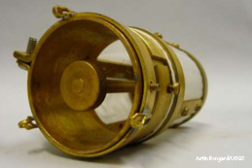
Solutions
Lesson 3.1 Matter and the Environment
A mixture is a combination of elements, molecules, or compounds that are not bonded chemically.
Solutions are mixtures in which all ingredients are equally distributed.
Mixtures can be solids, liquids, or gases.
Blood, sea water, plant sap, and metal alloys, such as brass, are all solutions.
Notes:
Image - http://www.flickr.com/photos/carolynconner/4264882098/ (Creative Commons licensed)
Geyser info source - National Park Service: http://www.nps.gov/yell/planyourvisit/noldfaith.htm

Slide 8
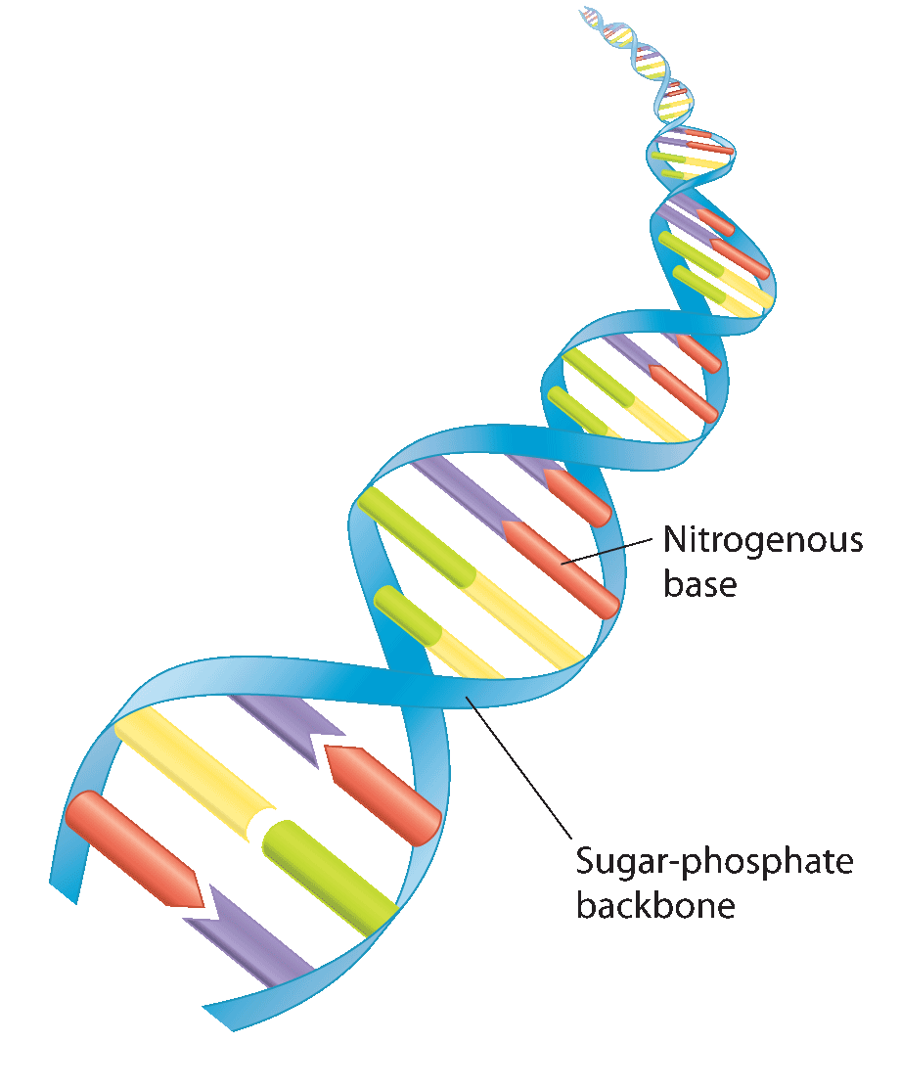
Macromolecules
Lesson 3.1 Matter and the Environment
Large organic compounds that are essential to life
Proteins: Serve many functions; include enzymes
Nucleic Acids: Direct protein production; include DNA and RNA
Carbohydrates: Provide energy and structure; include sugars, starch, and cellulose
Lipids: Not soluble in water; many functions; include fats, waxes, and hormones

Slide 9
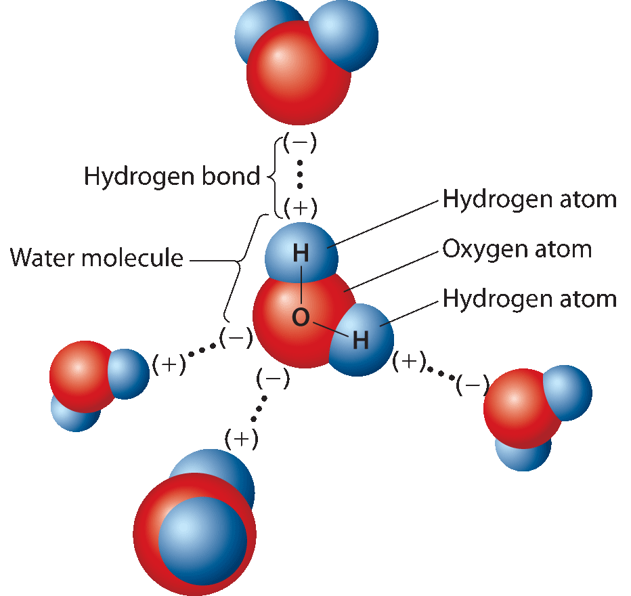
Water
Lesson 3.1 Matter and the Environment
Water is required by all living things for survival.
Hydrogen bonding gives water many unique properties:
Cohesion
Resistance to temperature change
Less dense when frozen
Ability to dissolve many other molecules

Slide 10
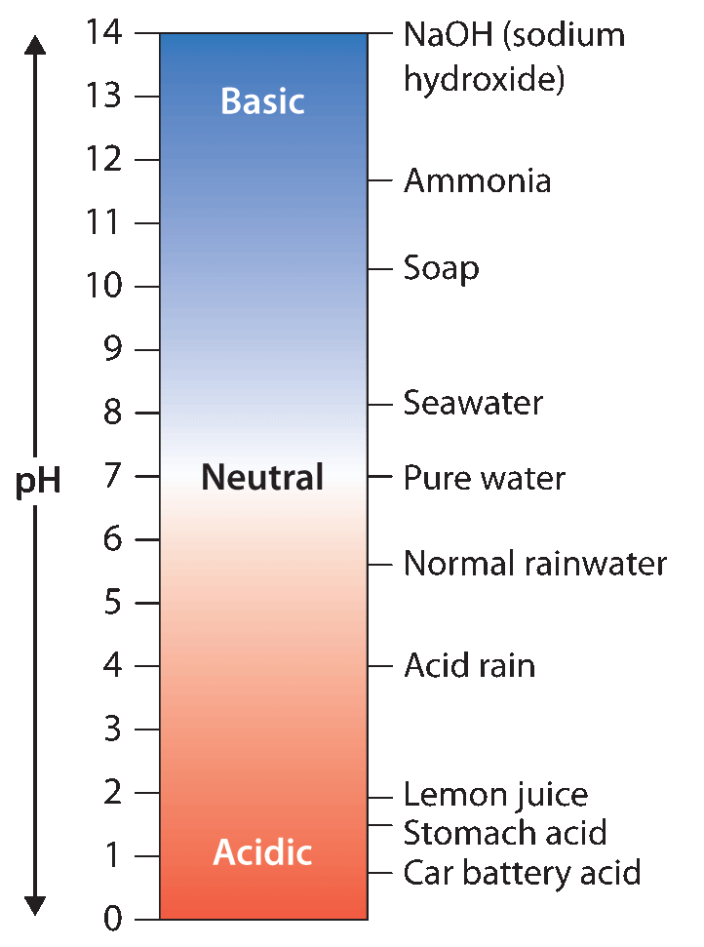
Acids, Bases, and pH
Lesson 3.1 Matter and the Environment
The separation of water molecules into ions causes solutions to be acidic, basic, or neutral.
The pH scale measures how acidic or basic a solution is.
pH of 7—Neutral: Equal concentrations of H⁺ and OH⁻
pH below 7—Acidic: Relatively high concentration of H⁺
pH above 7—Basic: Relatively high concentration of OH⁻

Slide 11
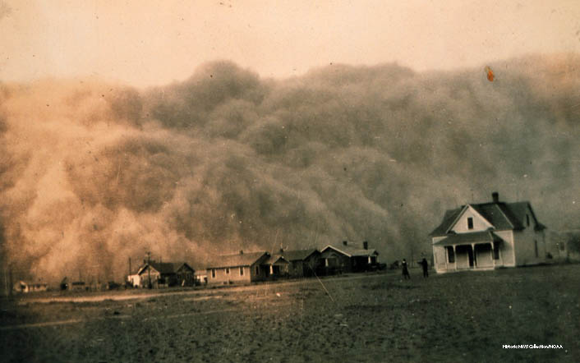
Lesson 3.2 Systems in Environmental Science
Positive feedback loops can help erosion turn a fertile field to desert in just a few years.
Dust storm, Stratford Texas, 1930s

Slide 12
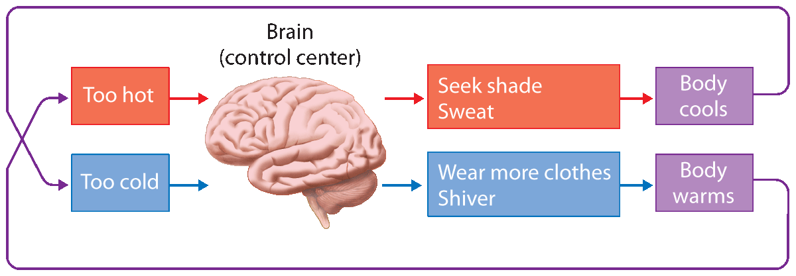
Interacting Systems
Lesson 3.2 Systems in Environmental Science
Inputs into Earth’s interconnected systems include energy, information, and matter.
Feedback loops regulate systems.
Negative feedback loops: Result in stabilization of a system
Positive feedback loops: Result in a system moving to an extreme
Negative feedback loop
Did You Know? Predator-prey cycles are negative feedback loops. If prey populations rise, predator populations can rise in response, causing prey populations to fall. Then predator populations may decline, allowing prey populations to rise again, and so on.

Slide 13
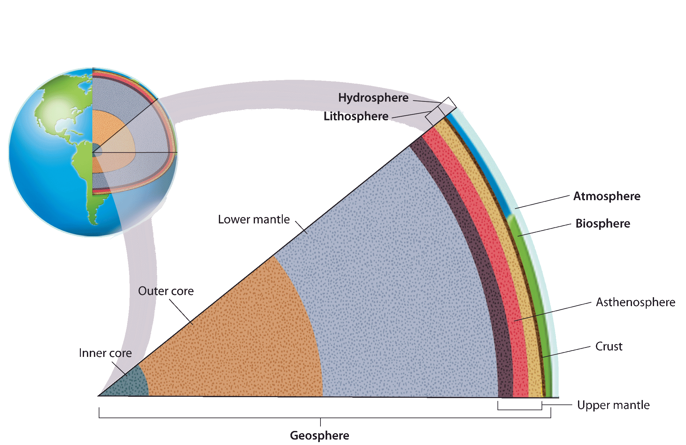
Spheres of Function
Lesson 3.2 Systems in Environmental Science
Earth can be divided into spheres that are defined according to their location and function.

Slide 14
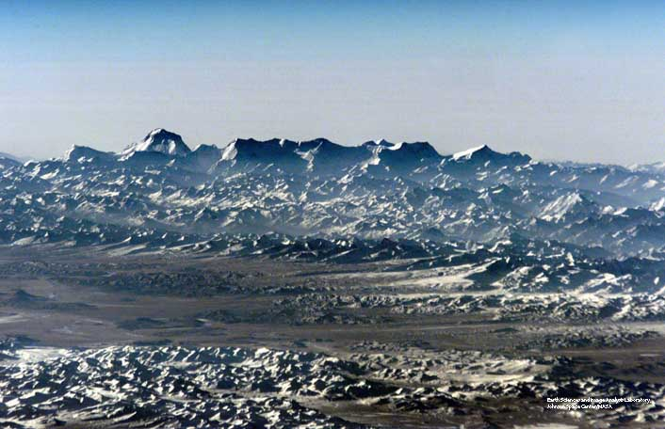
Lesson 3.3 Earth’s Spheres
The movement of Earth’s plates has formed the deepest ocean trenches and the highest mountains.

Slide 15
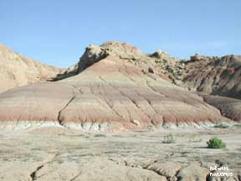
The Geosphere
Lesson 3.3 Earth’s Spheres
Rocks and minerals on and below Earth’s surface:
Crust: Thin, cool, rocky outer “skin”
Mantle: Very hot and mostly solid
Core: Outer core is molten metal, inner core is solid metal
Rock formation, Ouray National Wildlife Refuge, Utah

Slide 16
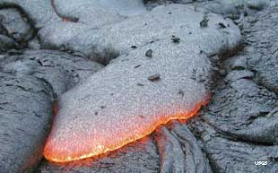
Plate Tectonics
Lesson 3.3 Earth’s Spheres
Crust and mantle are divided into:
Lithosphere: Crust and uppermost mantle; divided into tectonic plates
Asthenosphere: Soft middle mantle; heated by outer core
Lower mantle: Solid rock
Convection currents in the asthenosphere move tectonic plates.
Collisions and separations of the plates result in landforms.
Volcano lava

Slide 17
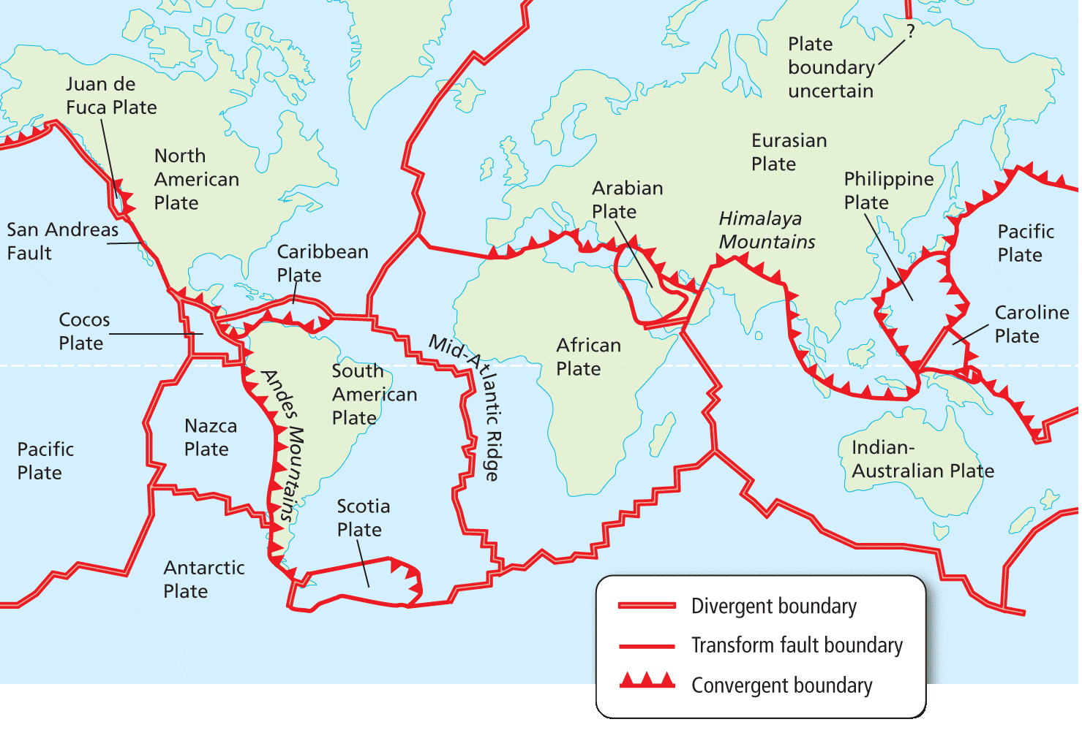
Tectonic Plates
Lesson 3.3 Earth’s Spheres
There are three major types of plate boundary:
Divergent
Transform
Convergent

Slide 18
Divergent and Transform Plate Boundaries
Lesson 3.3 Earth’s Spheres
Divergent boundaries: Rising magma pushes plates apart.
Transform boundaries: Plates slip and grind alongside one another.
Divergent plate boundary
Transform plate boundary

Slide 19
Convergent Plate Boundaries
Lesson 3.3 Earth’s Spheres
Plates collide, causing one of two things to happen:
Subduction: One plate slides beneath another.
Mountain-building: Both plates are uplifted.

Slide 20
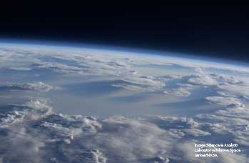
The Biosphere and Atmosphere
Lesson 3.3 Earth’s Spheres
Biosphere: The part of Earth in which living and nonliving things interact
Atmosphere: Contains the gases that organisms need, such as oxygen; keeps Earth warm enough to support life
Earth’s atmosphere, seen from space

Slide 21
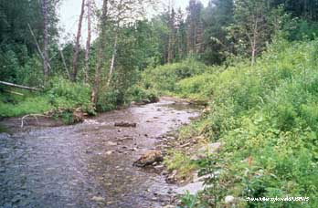
The Hydrosphere
Lesson 3.3 Earth’s Spheres
Consists of Earth’s water
Most of Earth’s water (97.5%) is salt water.
Only 0.5% of Earth’s water is unfrozen fresh water usable for drinking or irrigation.
Earth’s available fresh water includes surface water and ground water.
Greenlaw Brook, Limestone, Maine
Did You Know? If it is depleted, groundwater can take hundreds or even thousands of years to recharge completely.

Slide 22
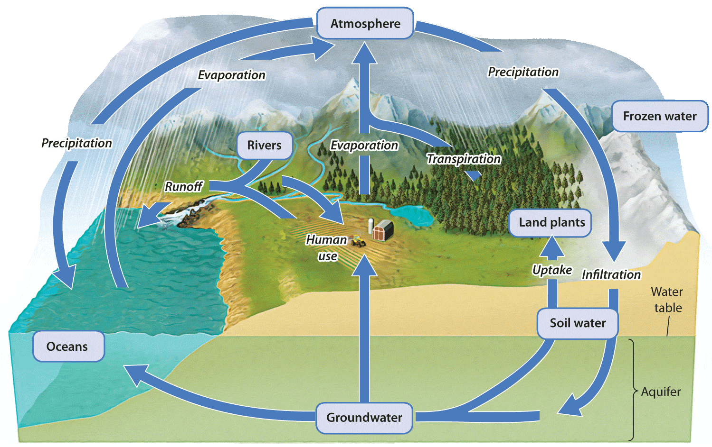
The Water Cycle
Lesson 3.3 Earth’s Spheres

Slide 23
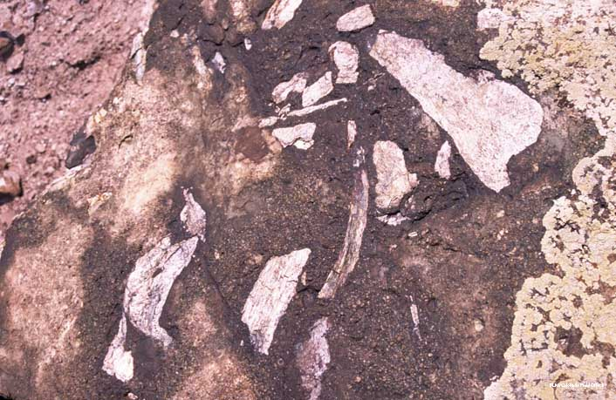
Lesson 3.4 Biogeochemical Cycles
A carbon atom in your body today may have been part of a blade of grass last year, or a dinosaur bone millions of years ago.
Fossilized bones in a Colorado dig.

Slide 24
Nutrient Cycling
Lesson 3.4 Biogeochemical Cycles
Matter cycles through the environment.
Matter can be transformed, but cannot be created or destroyed.
Nutrients, matter that organisms require for life process, circulate throughout the environment in biogeochemical cycles.
Did You Know? Organisms require several dozen nutrients, such as nitrogen, phosphorus, and carbon, to survive.

Slide 25
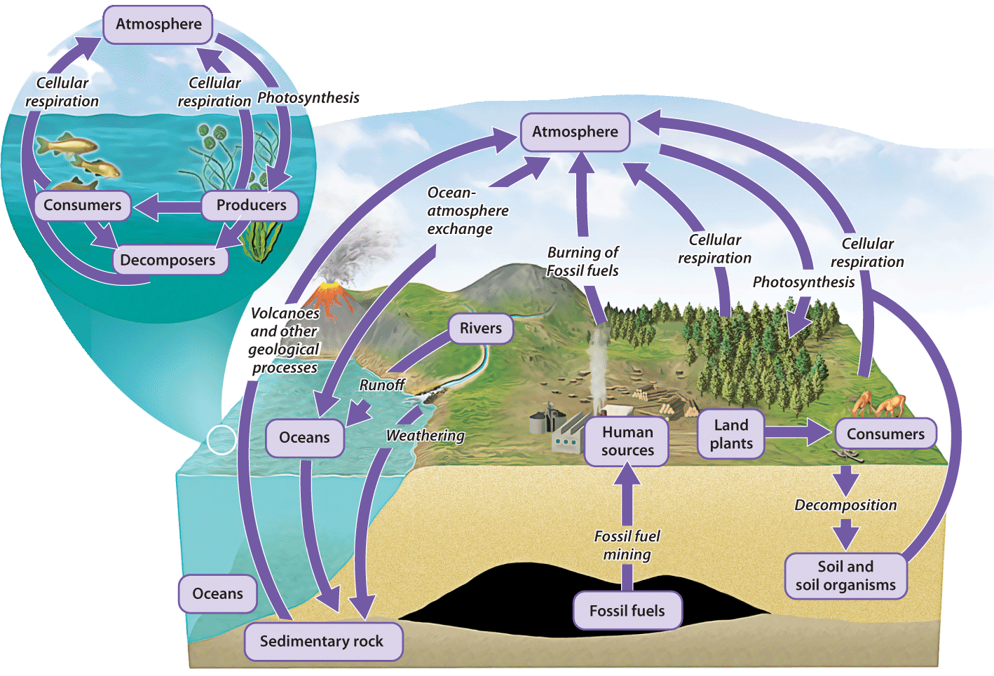
The Carbon Cycle
Lesson 3.4 Biogeochemical Cycles

Slide 26
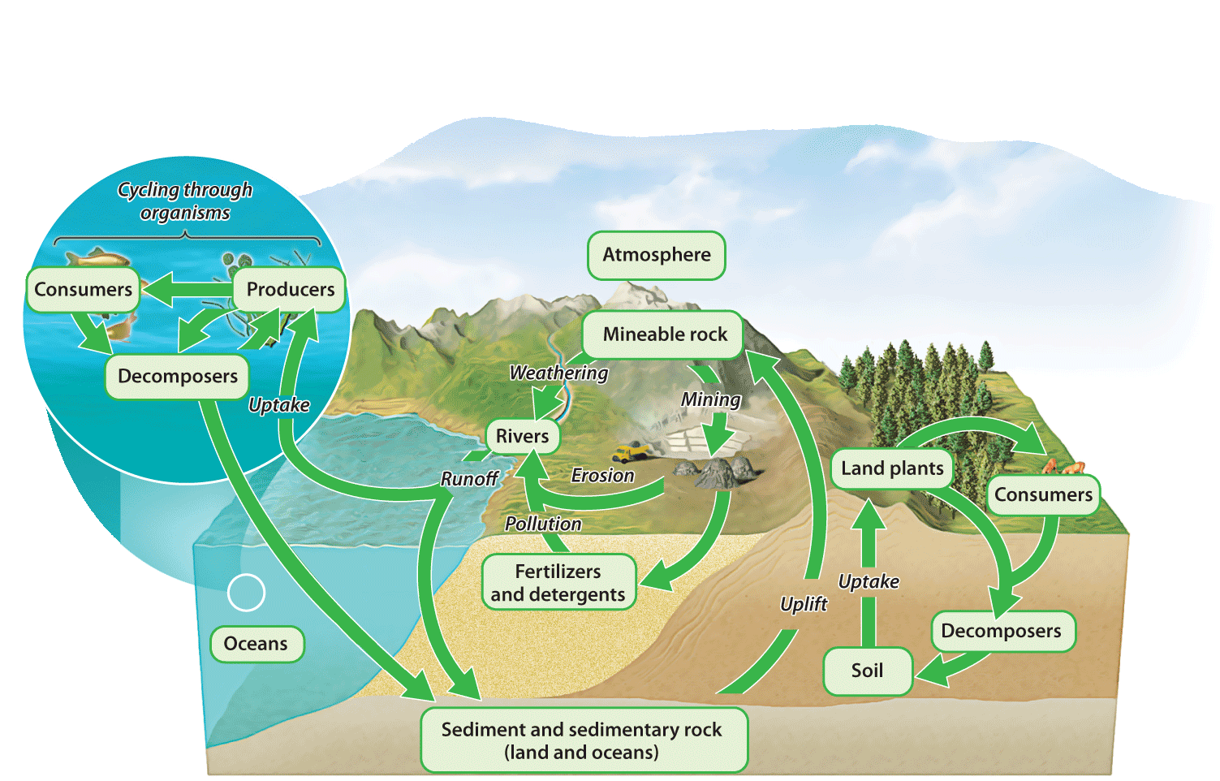
The Phosphorus Cycle
Lesson 3.4 Biogeochemical Cycles

Slide 27
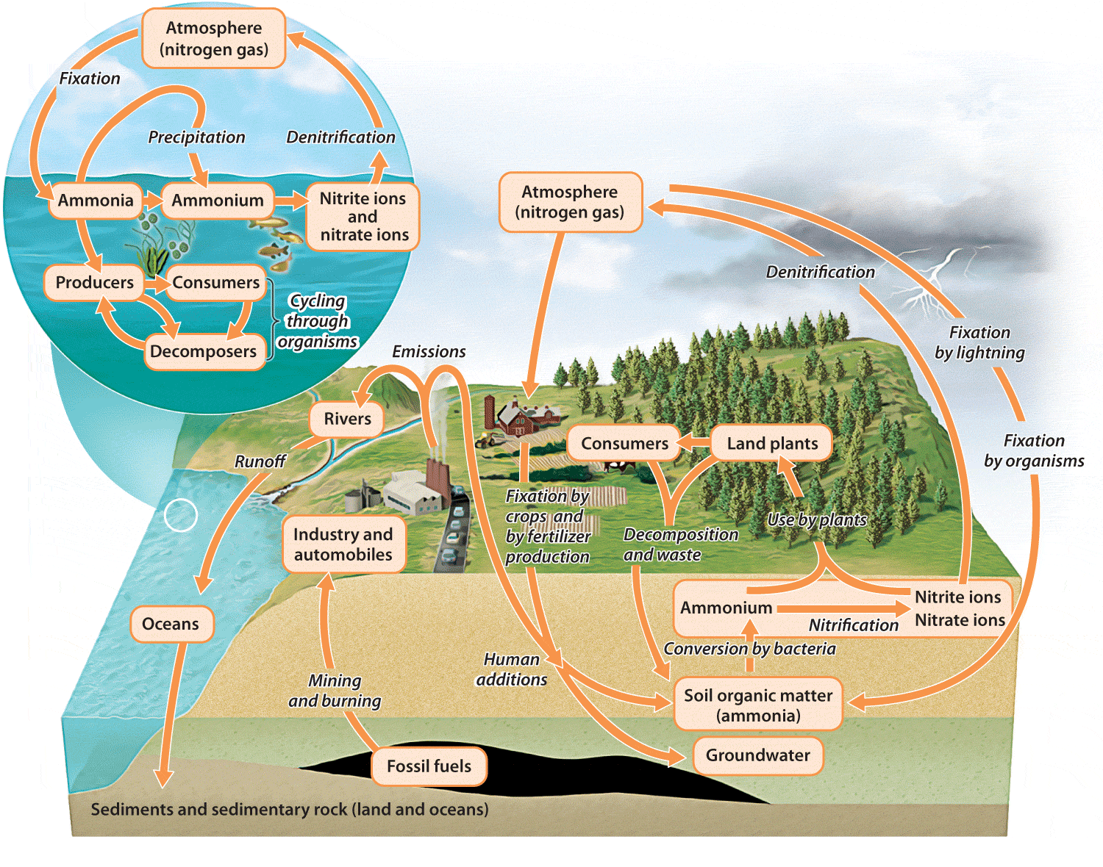
The Nitrogen Cycle
Lesson 3.4 Biogeochemical Cycles

